Slide 1
Problem Solving with C Programming Language
Unit 4 Iterative Statements in C Programming Language

Slide 2
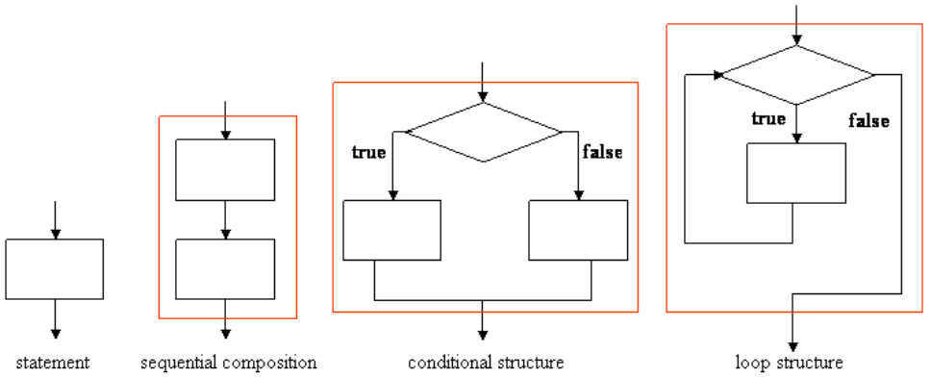
Flowchart
The control structures of a high-level programming language include four types: basic statement, sequential composition, conditional structure, and loop structure.
These control structures are expressed using the following flowchart diagrams:

Slide 3
Flowchart (cont’d)
The rectangular box denotes a statement and the diamond box denotes a condition.
These control structures have a common property, i.e., each of them has one entry point and one exit point.
A basic statement is either an simple assignment or a composed statement in C programming language.
A sequential composition is two statements connected by a semicolon (;) in C.
A conditional structure is implemented as a if-then-else statement in C.
A loop structure is implemented as a while-loop statement in C.
The incoming arrow and outgoing arrow of the red box in the last three composed structures are the one entry point and the one exit point, respectively.
The four basic control structures are called D-structure following from the originator Edsger W. Dijkstra (1930-2002).

Slide 4
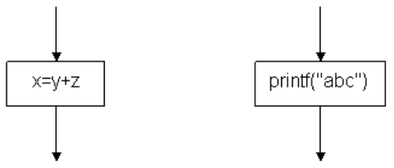
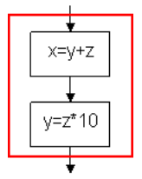
Flowchart (cont’d)
The basic control structure may be a single assignment statement or a function call such as x=y+z or printf("abc") as the two boxes below:
A sequence of statements connected by semicolons is using sequential composition. For example, x=y+z; y=z*100 can be expressed using the following flowchart.
The two boxes are grouped together to become a large one-entry-one-exit control structure.

Slide 5
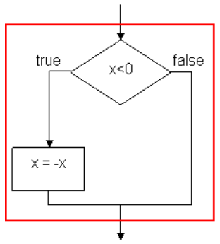
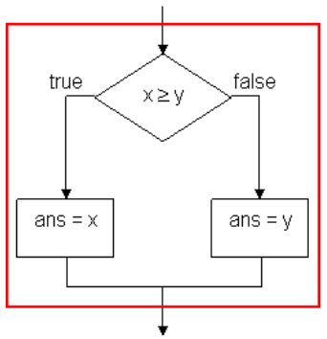
Flowchart (cont’d)
For conditional structure, we revisit the if-then statement of the absolute value:
if (x<0) x = -x;
The if-then-else of the maximum function is:
if (x>=y) ans = x;
else ans = y;

Slide 6
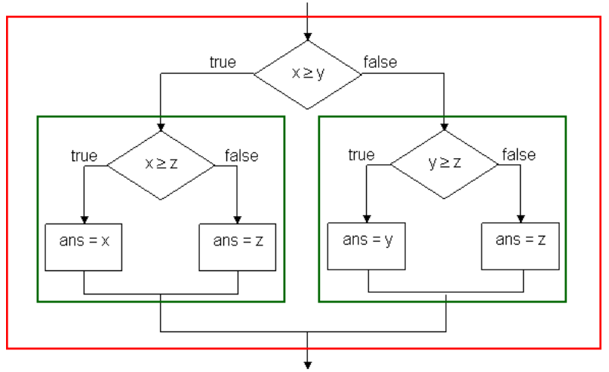
Flowchart (cont’d)
Nested conditional statements are drawn as multiple conditional structures:
if (x>=y) {
if (x>=z) ans = x;
else ans = z;
}
else {
if (y>=z) ans = y;
else anz = z;
}

Slide 7
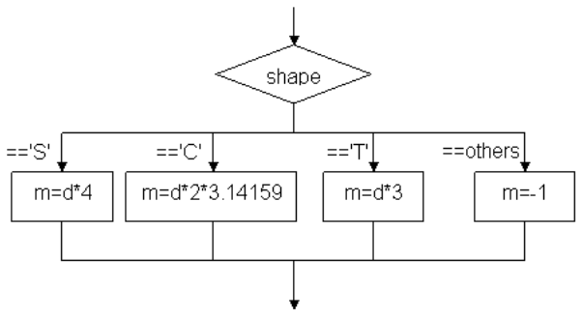
Flowchart (cont’d)
switch-case statement with break statement in each case:
switch (shape) {
case 'S': { m = d * 4; break; }
case 'C': { m = d * 2 * 3.14159; break; }
case 'T': { m = d * 3; break; }
default: { m = -1; }
}

Slide 8
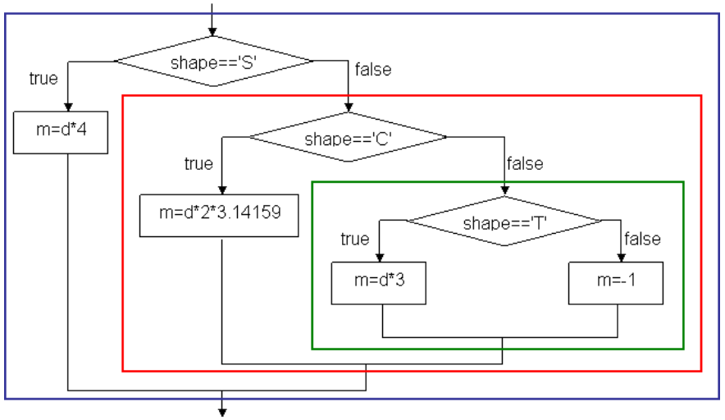
Flowchart (cont’d)
The corresponding flowchart below is constructed by the four one-entry-one-exit basic control structures as below:

Slide 9
Definite Loops
C programming langauge provides loop constructs to accomplish iterative computation.
The first loop construct is for-loop definite loop with the following syntax:
Syntax: for (initiator; condition; modifier) statement;
The first part initiator is an assignment or a sequence of assignments that initialize some variables called loop variables.
The second part condition is a loop condition which is evaluated at the beginning of every iteration.
If the loop condition is true than the body statement will be executed; otherwise execution of the loop terminates.
The third expression modifier is an assignment or sequence of assignments that modify the values of loop variables at the end of every iteration.
Note that initiator, condition, and modifier are separated by semicolons (;).
If initiator, condition, or modifier has more than one statements or expressions, the statements and expressions are separated by commons (,).

Slide 10
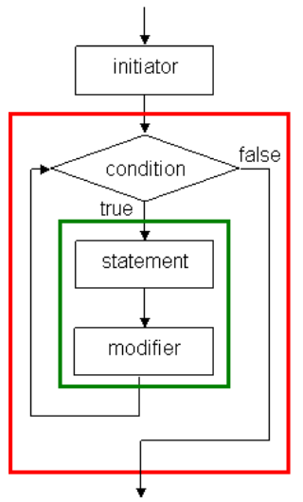
Definite Loops (cont’d)
A for-loop can be drawn as the following one-entry-one-exit control structure:
In the flowchart, initiator is evaluated before the loop and condition becomes the loop condition, and statement and modifier make up the loop body.

Slide 11
Definite Loops (cont’d)
Program average_score.c uses a for-loop to accumulate the total score of ten students.
average_score.c
average_score.exe
1
2
3
4
5
6
7
8
9
10
11
12
#include <stdio.h>
int main(void) {
int score[10] = {78, 65, 90, 55, 82, 70, 49, 92, 82, 68};
int i;
float total = 0.0;
for (i=0; i<10; i++) total += score[i];
printf("Average score: %4.2f\n", total / 10.0);
return 0;
}
Average score: 73.10
Using loop construct, it is easy to write a program to compute the average score of 100 students or larger. We simply change the loop condition according to the number of students.

Slide 12
Definite Loops (cont’d)
Program highest_score.c that reads the scores of ten students and set the highest score to variable max. The first for-loop reads the scores and the second for-loop set the highest score.
highest_score.c
1
2
3
4
5
6
7
8
9
10
11
#include <stdio.h>
int main(void) {
int score[10];
int max, i;
for (i=0; i<10; i++) {
printf("Enter the score of student No. %d: ", i+1);
scanf("%d", &score[i]);
}
max = -1;
12
13
14
15
16
17
18
for (i=0; i<10; i++) {
if (max<score[i]) max = score[i];
}
printf("\nThe highest score is %d.\n", max);
return 0
}
The first for-loop reads the scores and the second for-loop set the highest score.

Slide 13
Definite Loops (cont’d)
highest_score.exe
Enter the score of student No. 1: 72
Enter the score of student No. 2: 64
Enter the score of student No. 3: 52
Enter the score of student No. 4: 89
Enter the score of student No. 5: 60
Enter the score of student No. 6: 92
Enter the score of student No. 7: 48
Enter the score of student No. 8: 79
Enter the score of student No. 9: 80
Enter the score of student No. 10: 77
The highest score is 92.

Slide 14
Indefinite Loops
An indefinite loop is a loop whose loop body will be executed as long as its loop condition holds.
Hence, it is difficult to tell exactly how many iterations will be executed for an indefinite loop.
C programming language supports two kinds of indefinite loops: while-loop and do-while-loop.
The syntax of while-loop is:
Syntax: while (condition) statement;
The semantics of while-loop is to evaluate condition first. If condition is evaluated to true (a value other than zero), statement will be executed.
When execution of statement completes, repeat the while-loop. Once condition is evaluated to false (zero), the while-loop terminates.
Hence, while-loop is exactly the one-entry-one-exit loop control structure.

Slide 15
Indefinite Loops (cont’d)
Program character_scan_while.c reads one character a time up to 30 characters or encountering a terminating character '|'.
character_scan_while.c
character_scan_while.exe
1
2
3
4
5
6
7
8
9
10
11
12
13
14
15
#include <stdio.h>
int main(void) {
char c[31];
int i = 0;
while (i<30 && c[i]!='|') {
scanf("%c", &c[i]);
if (c[i]!='|') i++;
}
c[i] = '\0';
printf("\nThe character string is:\n%s\n", c);
return 0;
}
A string of !@#$%^&*()_+|
The character string is:
A string of !@#$%^&*()_+
Function call scanf("%c", &c[i]) reads a single character including space, tab, line feed, carriage return control characters, and non-printable characters.
Since it is not known how many characters will be scanned, an indefinite while-loop is used.
The loop will terminate when 30 characters are scanned or the vertical bar '|' is scanned.

Slide 16
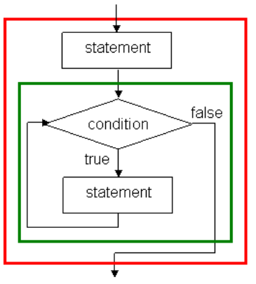
Indefinite Loops (cont’d)
The syntax of do-while loop is:
Syntax: do statement while (condition);
The semantics of do-while loop is to execute statement and then to evaluate condition. If condition is evaluated to true, repeat the do-while loop; otherwise the loop terminates.
Unlike while loop, the loop body statement of do-while loop is executed at least once.
In fact, do-while loop is equivalent to the following program construct:
statement;
while (condition) statement;

Slide 17
Indefinite Loops (cont’d)
Program character_scan_do_while.c reads at least one character.
character_scan_do_while.c
character_scan_do_while.exe
1
2
3
4
5
6
7
8
9
10
11
12
13
14
#include <stdio.h>
int main(void) {
char c[31];
int i = 0;
do {
scanf("%c", &c[i]);
} while (i<30 && c[i++]!='|');
c[i] = '\0';
printf("\nThe character string is:\n%s\n", c);
return 0;
}
A string of !@#$%^&*()_+|
The character string is:
A string of !@#$%^&*()_+|
Note that there is a minor difference that this program will output the terminating character '|', if the number characters is less than 30.

Slide 18
Pseudo Code
To solve a problem in computer, we must express the solution in a method that is suitable of implementation using the above control structures.
First, a solution is written as a pseudo code. Let us recall the stepwise conversion of a decimal integer to a binary numeral
Input: decimal number d.
Output: binary number b of the same value as d.
Let b be a "NULL" binary value.
Divided d by 2. Attach the remainder to the left-hand-side of b and set d to be the quotient.
If d≥2, repeat Step 2; otherwise, attach d to the left-hand-side of b.

Slide 19
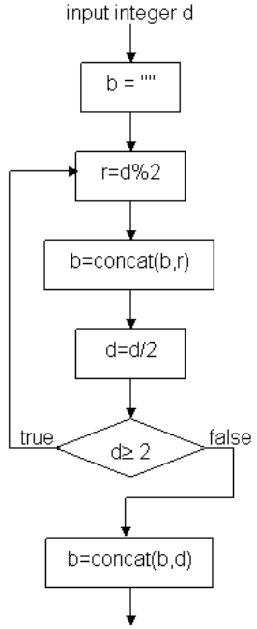
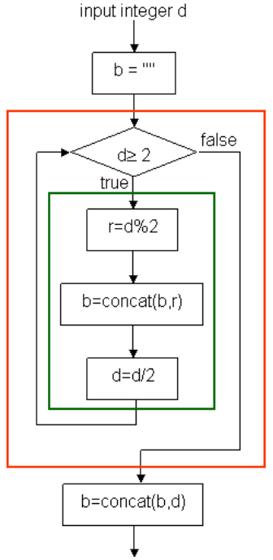
Pseudo Code (cont’d)
The flowchart on the left-hand-side is equivalent to the flowchart on the right-hand-side which is constructed by the four types of one-entry-one-exit control structure.
Function concat(b,r) is to append r at the left-hand-side of b.

Slide 20
Pseudo Code (cont’d)
The statements in the green box are sequentially composed as a block statement.
The while-loop in the red box is composed to form a one-entry-one-exit statement.
According to the modified flowchart, the pseudo code is rewritten to:
Input: decimal number d.
Output: binary number b of the same value as d.
Let b be a "NULL" binary value.
While d≥2, divided d by 2 and then attach the remainder to the left-hand-side of b and set d to be the quotient.
Attach d to the left-hand-side of b.
Flowcharts and pseudo codes are used to design solution of computing problems.

